Slide 1
Reconstructing Noisy Images with Sparse Representation
F14096148 邱柏穎

Slide 2
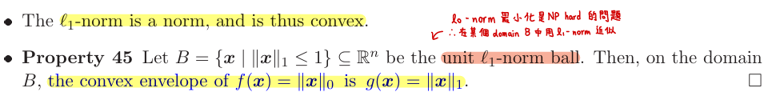
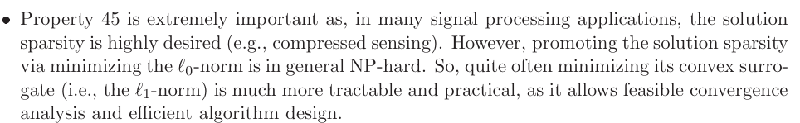
Motivation
Lecture Note p.37-38

Slide 3
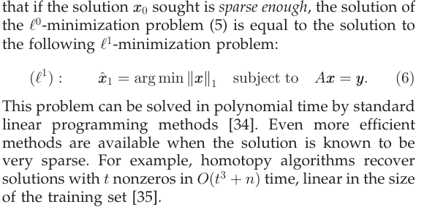
Concept
Wright, J., Yang, A. Y., Ganesh, A., Sastry, S. S., & Ma, Y. (2008).
Robust face recognition via sparse representation. IEEE transactions on pattern analysis and machine intelligence, 31(2), 210-227.

Slide 4
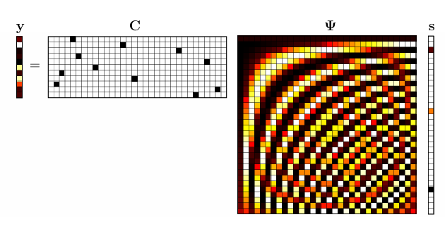
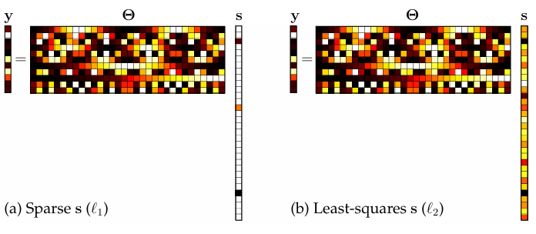
Concept

Slide 5
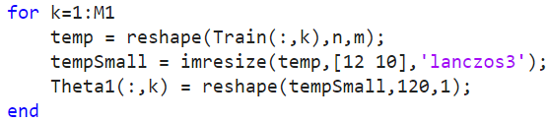
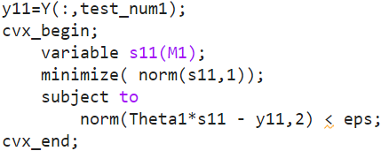
Code

Slide 6
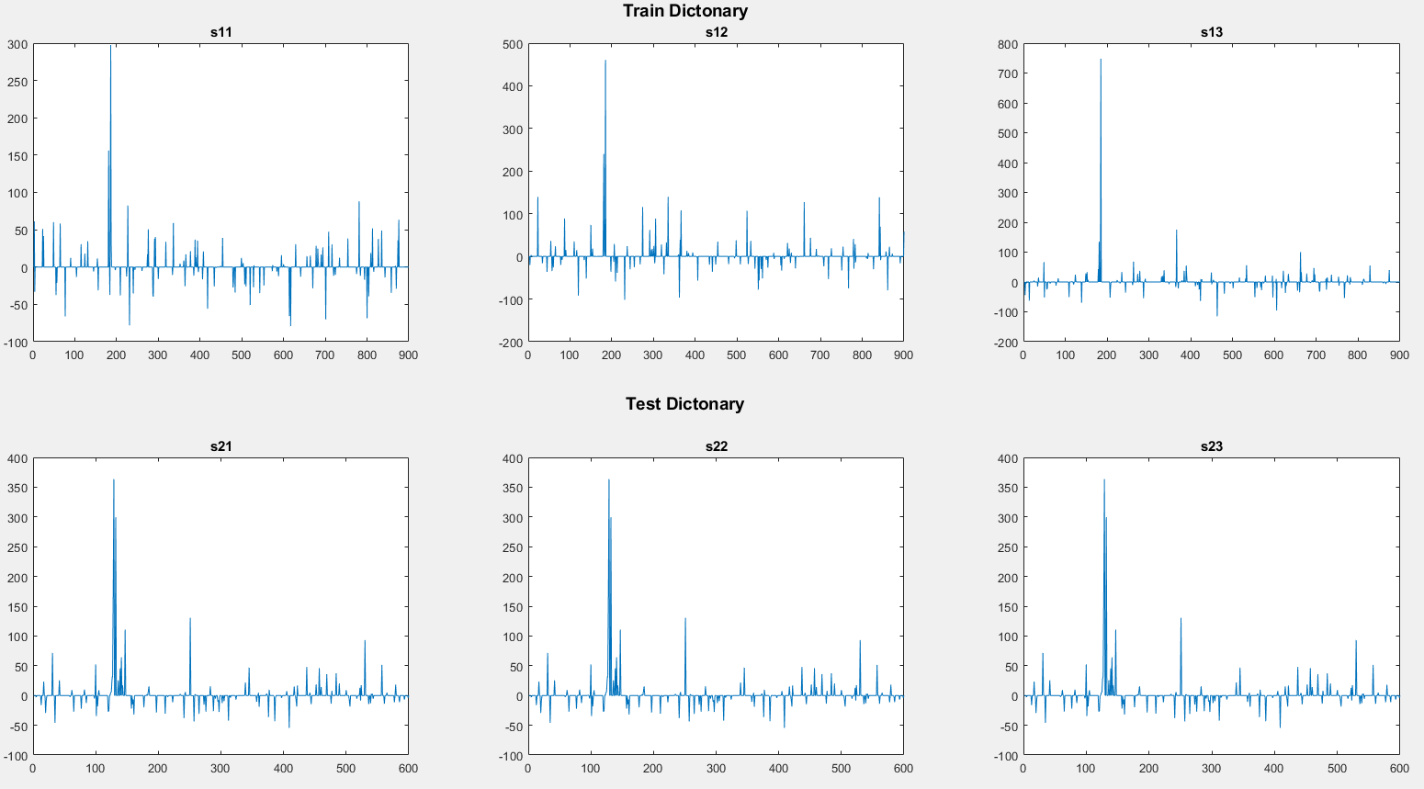
Result

Slide 7
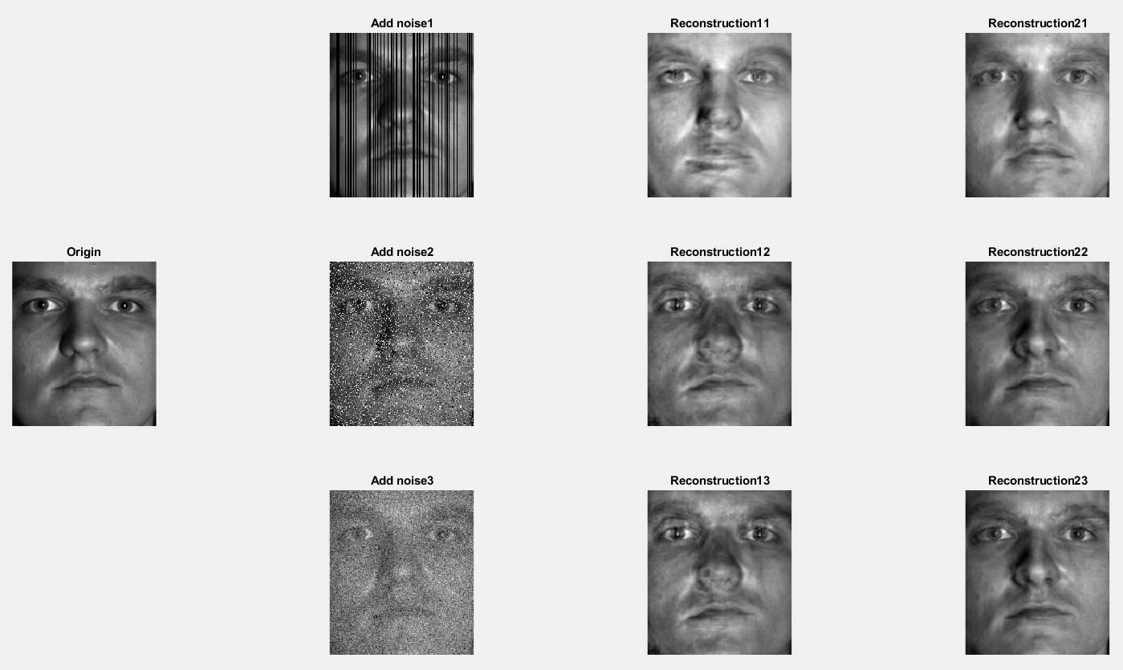
Result

Slide 8
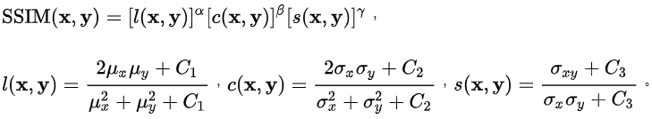
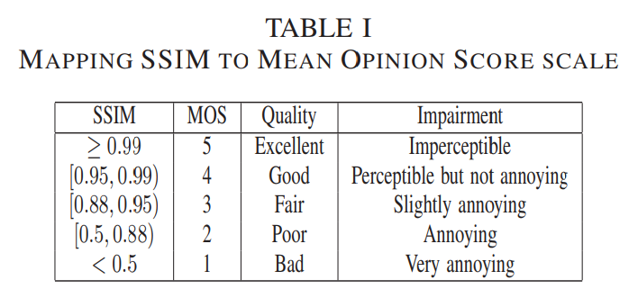
Result

Slide 9
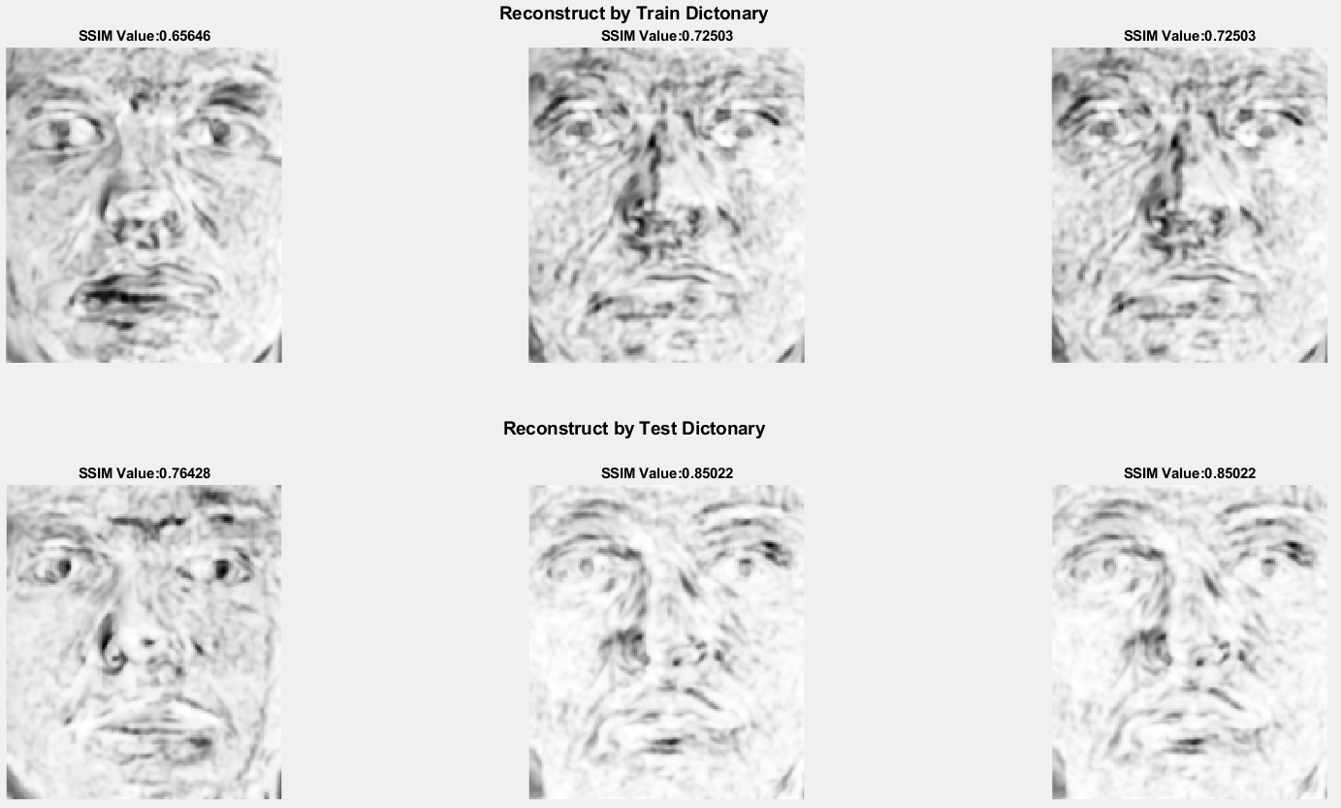
Result

Slide 10
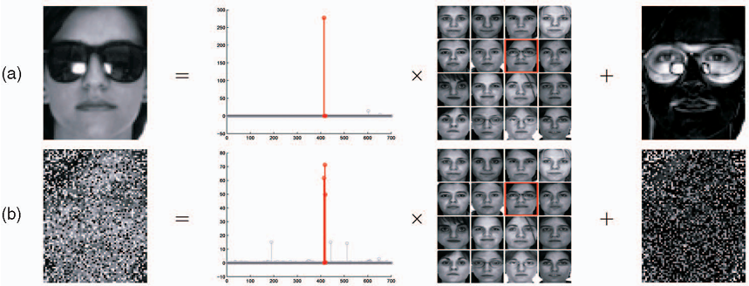
Reference

Slide 11
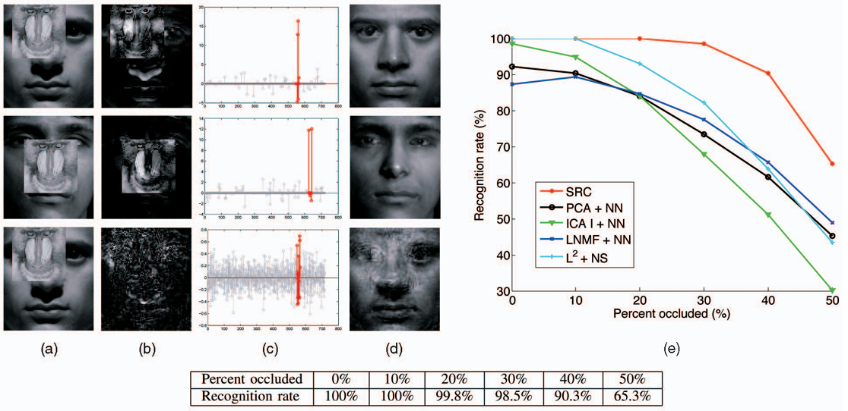
Reference

Slide 12
Reference
Wright, J., Yang, A. Y., Ganesh, A., Sastry, S. S., & Ma, Y. (2008). Robust face recognition via sparse representation. IEEE transactions on pattern analysis and machine intelligence, 31(2), 210-227.
Brunton, S. L., & Kutz, J. N. (2022). Data-driven science and engineering: Machine learning, dynamical systems, and control. Cambridge University Press.
Donoho, D. L. (2006). For most large underdetermined systems of linear equations the minimal 𝓁1‐norm solution is also the sparsest solution. Communications on Pure and Applied Mathematics: A Journal Issued by the Courant Institute of Mathematical Sciences, 59(6), 797-829.
Lecture Note

Slide 13
Thank you

